Slide 1
Introduction to Recurrent Neural Networks (RNN)
Session 9

Slide 2
Introduction
Recurrent Neural Network(RNN) are a type of Neural Network where the output from previous step are fed as input to the current step.
In traditional neural networks, all the inputs and outputs are independent of each other, but in cases like when it is required to predict the next word of a sentence, the previous words are required and hence there is a need to remember the previous words.
Thus RNN came into existence, which solved this issue with the help of a Hidden Layer.
The main and most important feature of RNN is Hidden state, which remembers some information about a sequence.

Slide 3
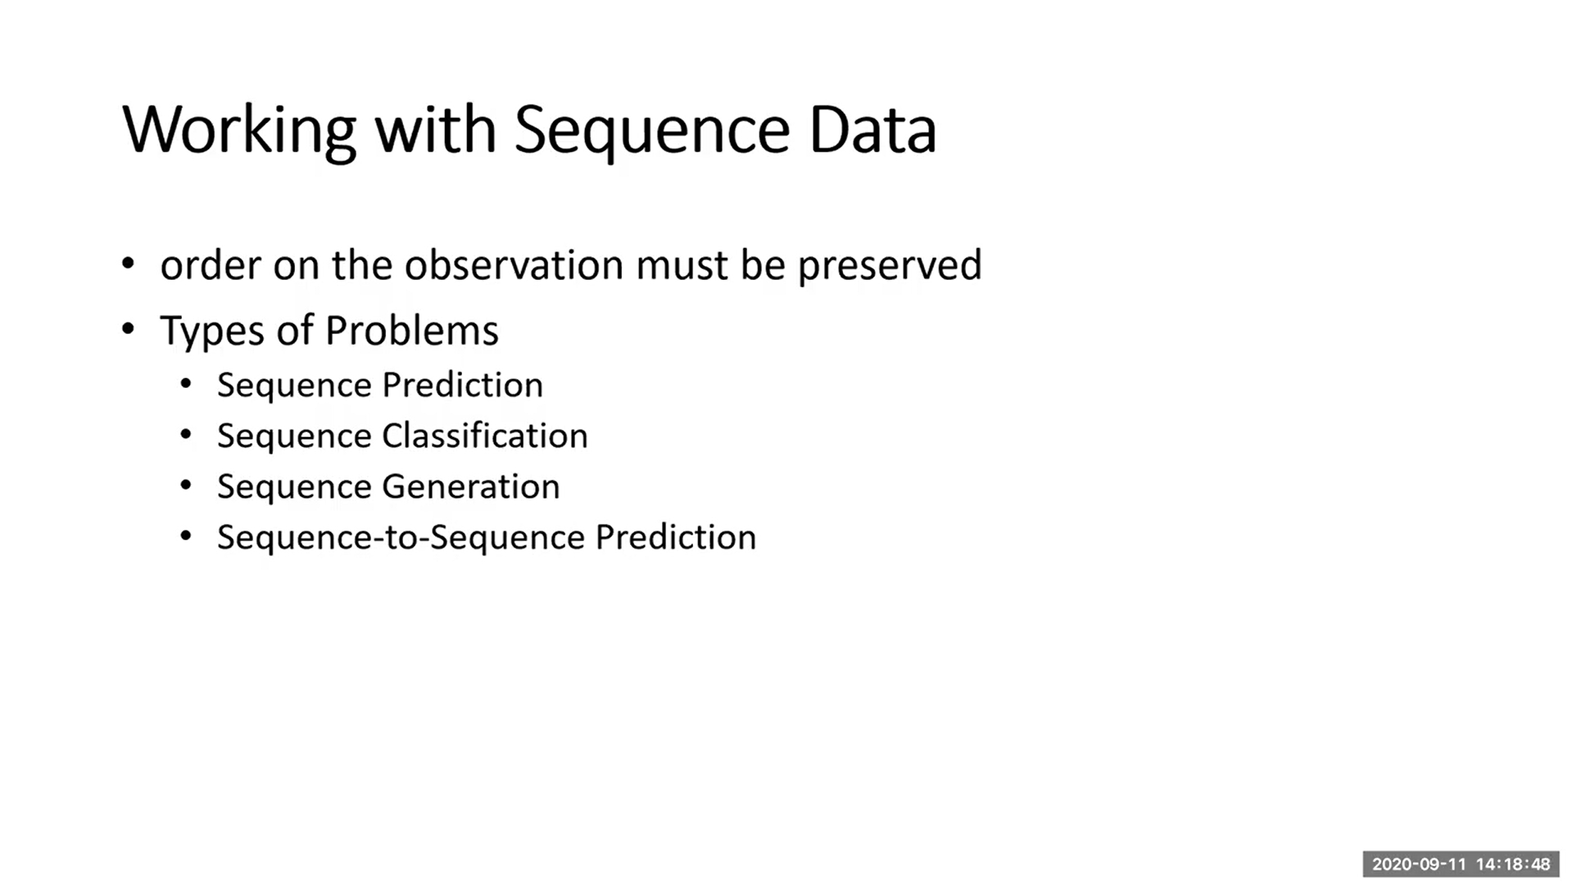

Slide 4
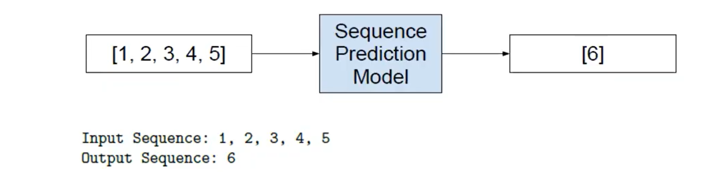
Sequence Prediction
Weather Forecasting
Stock Market Prediction
Product Recommendation

Slide 5
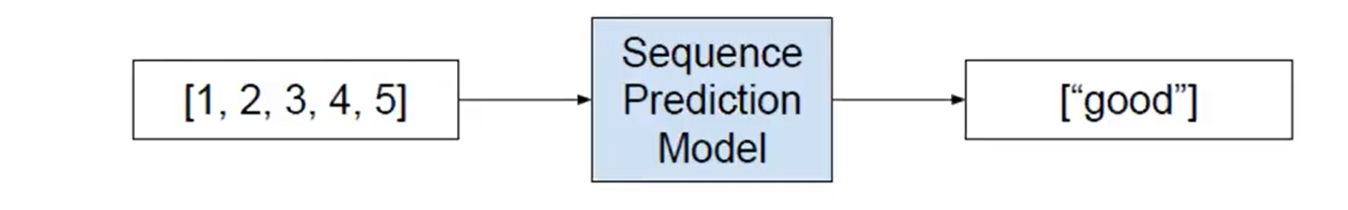
Sequence Classification
Anomaly Detection
Sentiment Analysis
DNA Sequence Classification

Slide 6
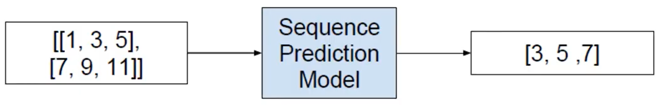
Sequence Generation
Text Generation
Music Generation
Image Caption Generation

Slide 7
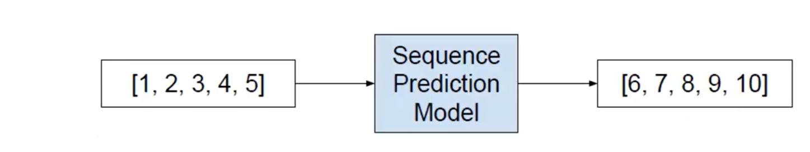
Sequence to Sequence
Text Summarization

Slide 8
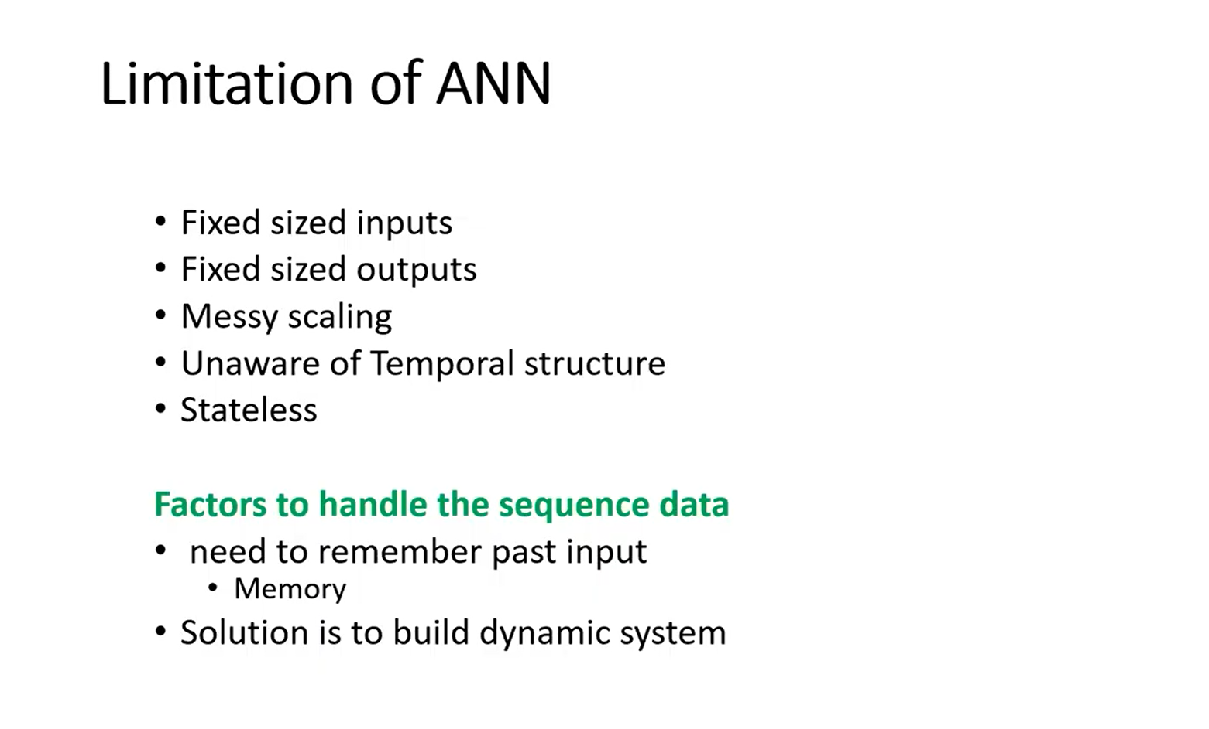

Slide 9
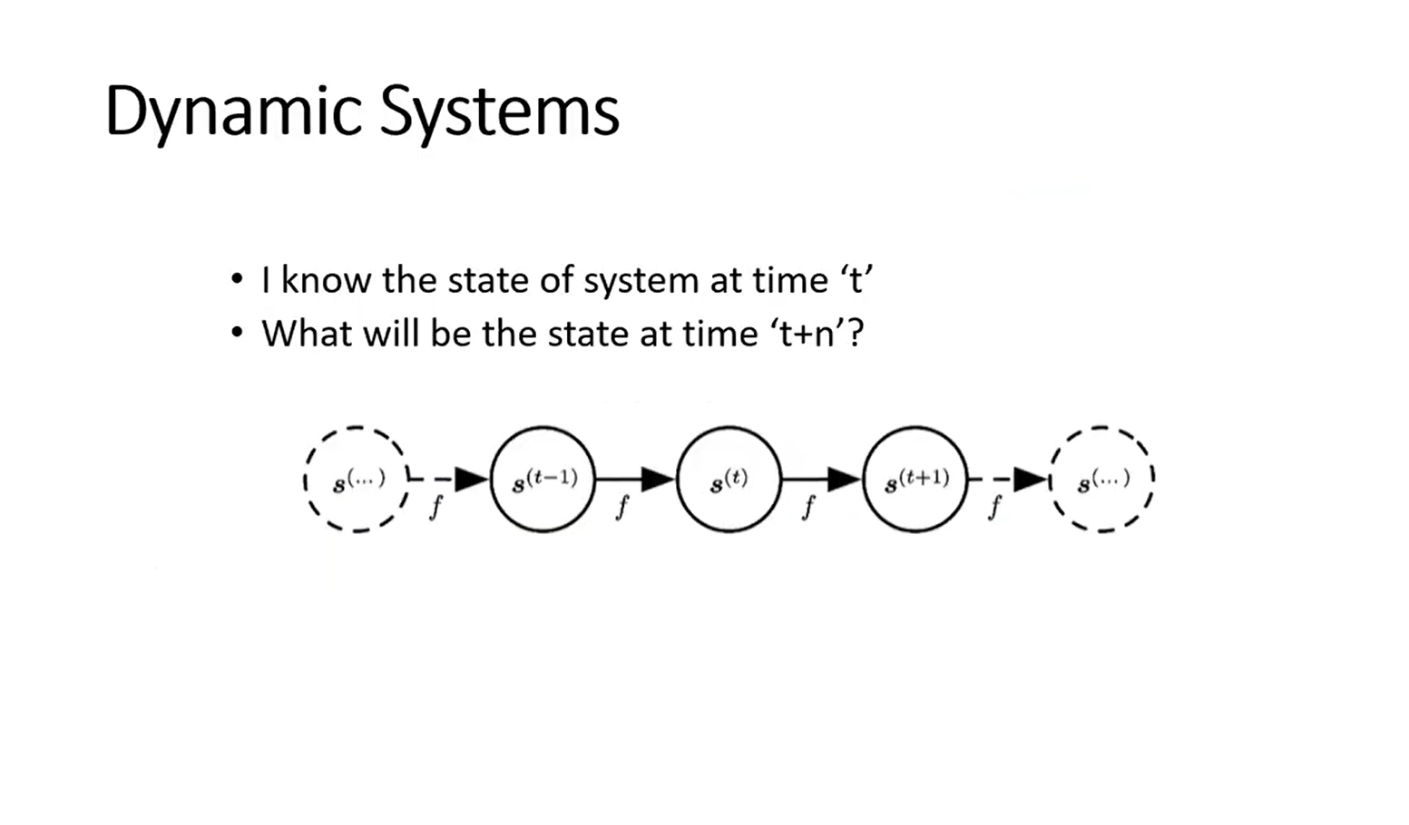

Slide 10
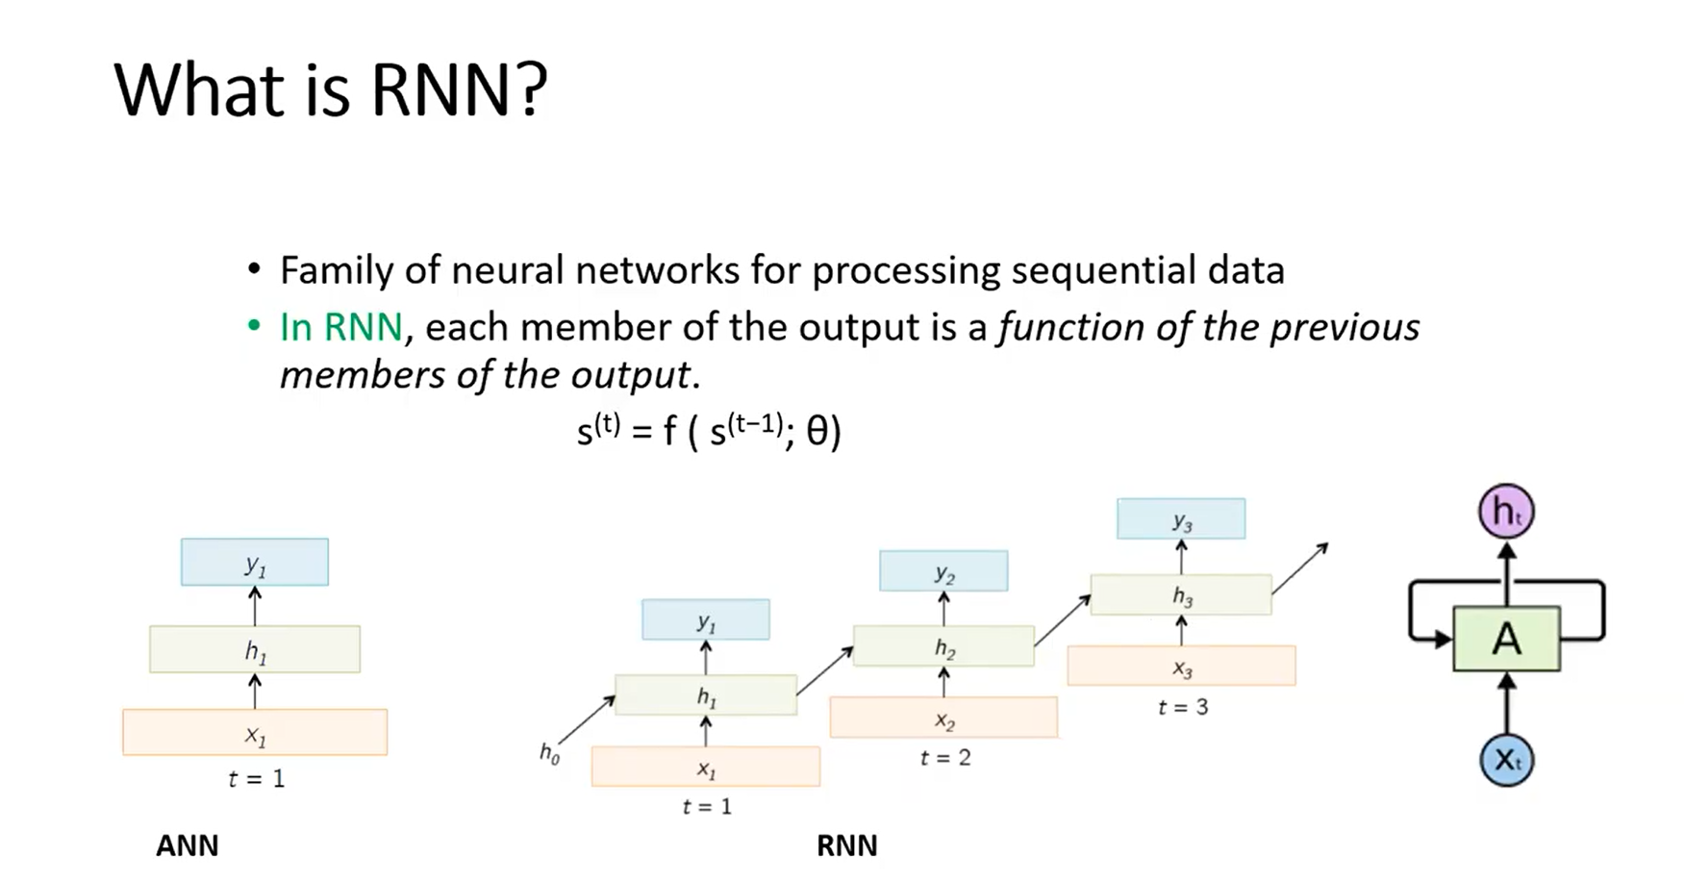

Slide 11
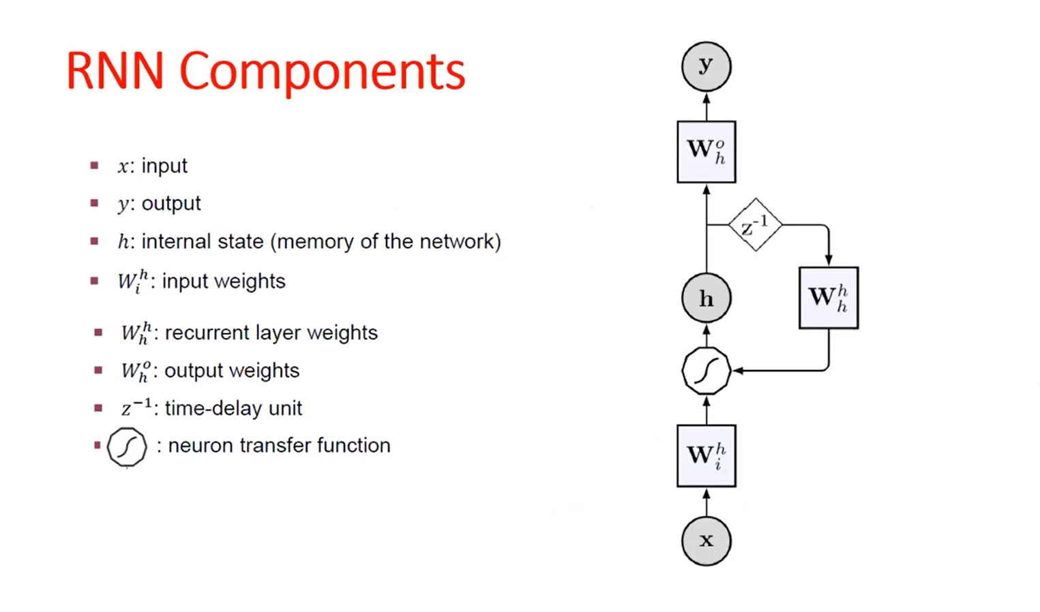

Slide 12
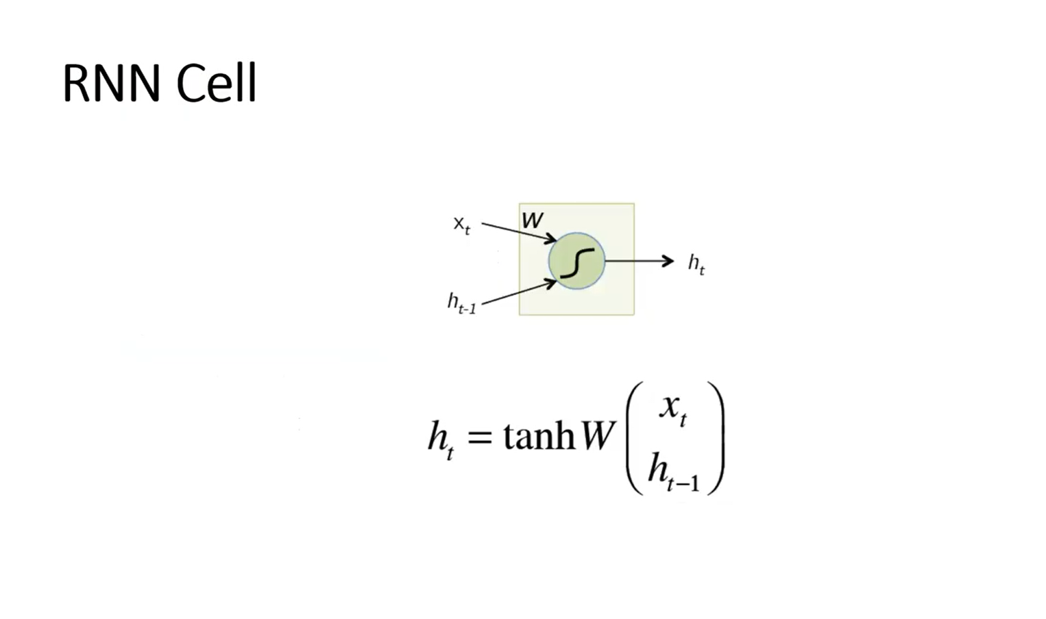

Slide 13
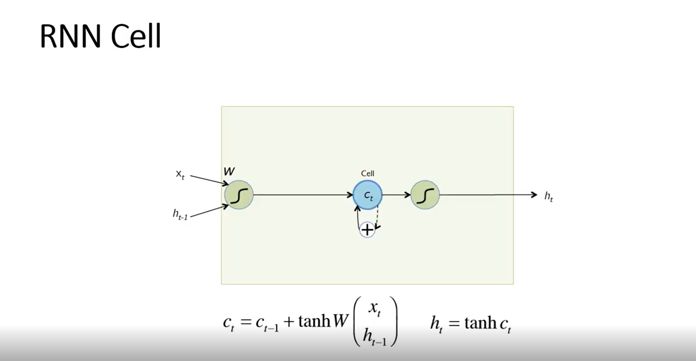

Slide 14
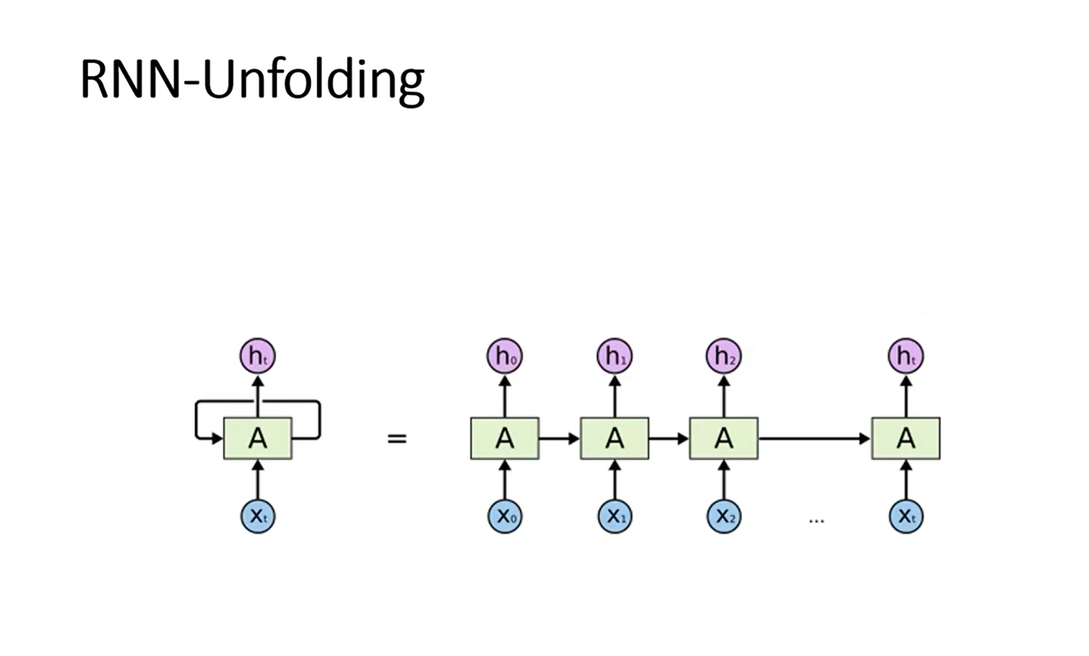

Slide 15
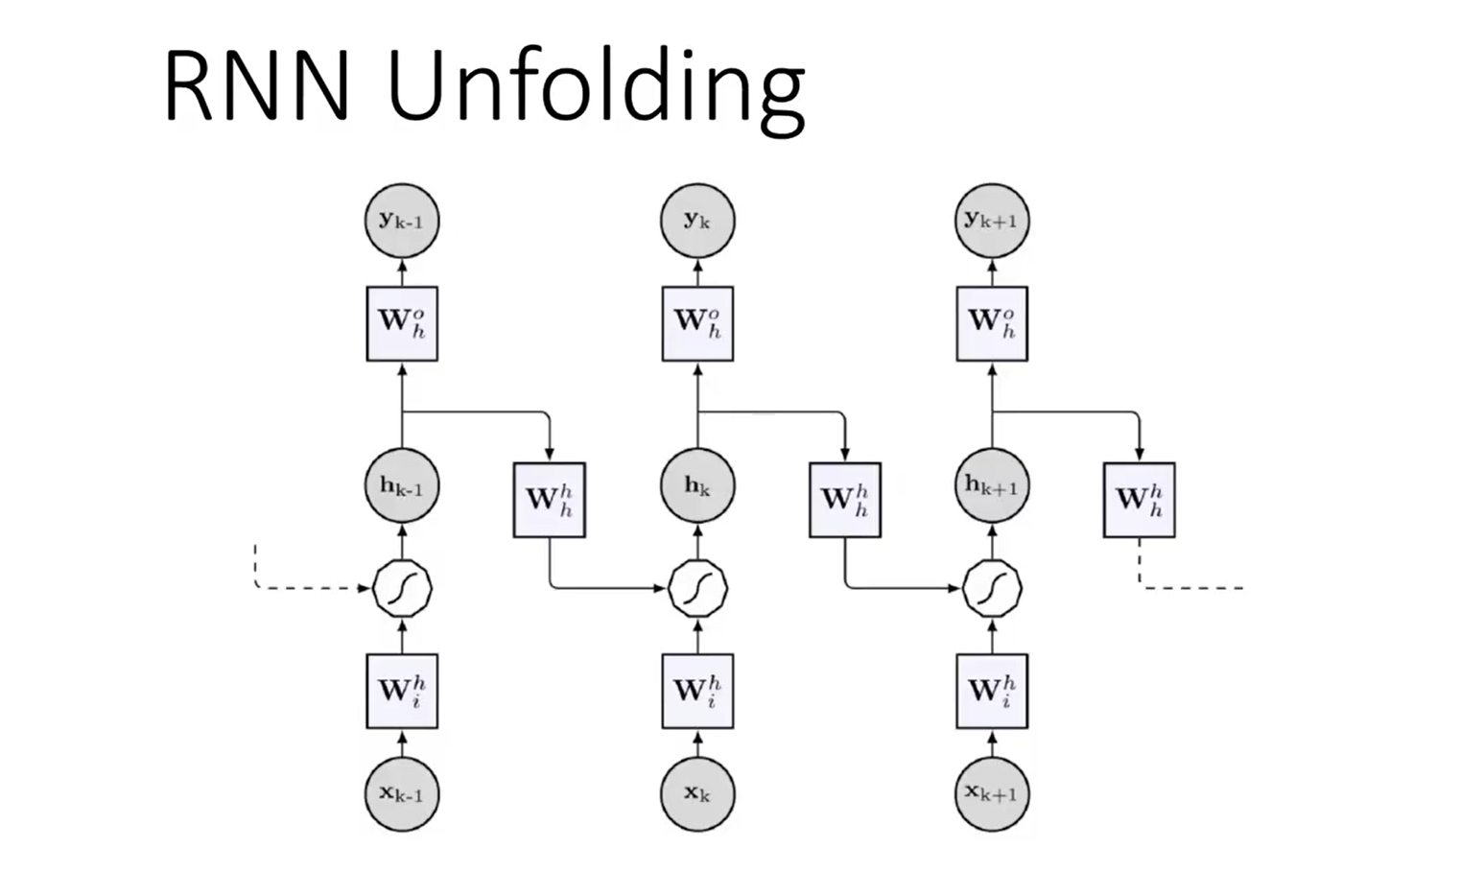

Slide 16
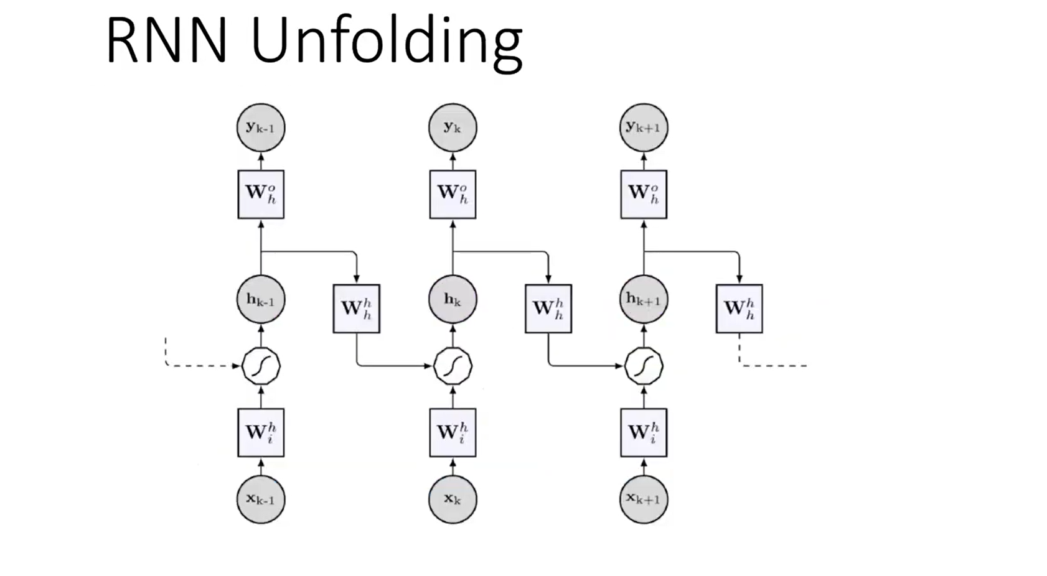

Slide 17
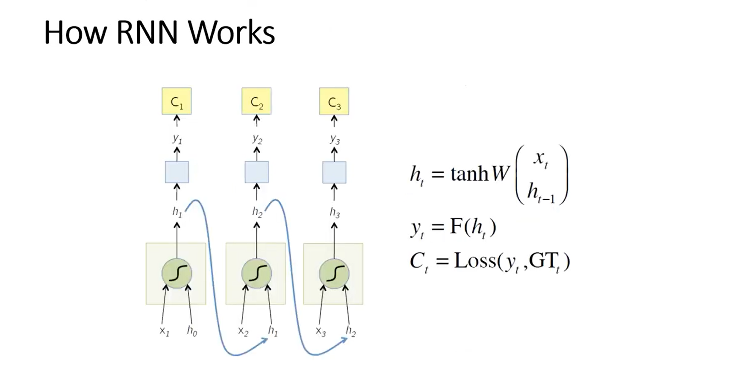

Slide 18
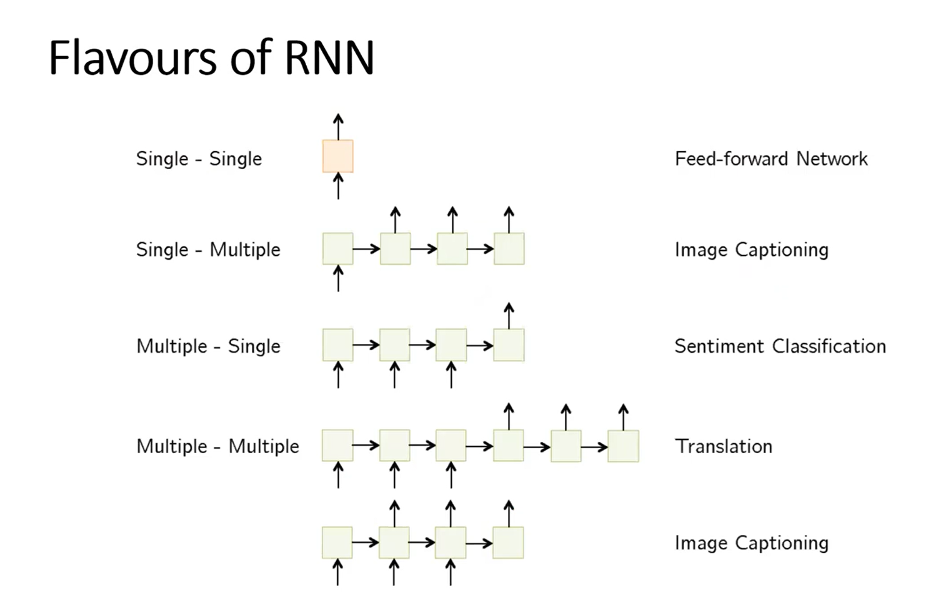

Slide 19
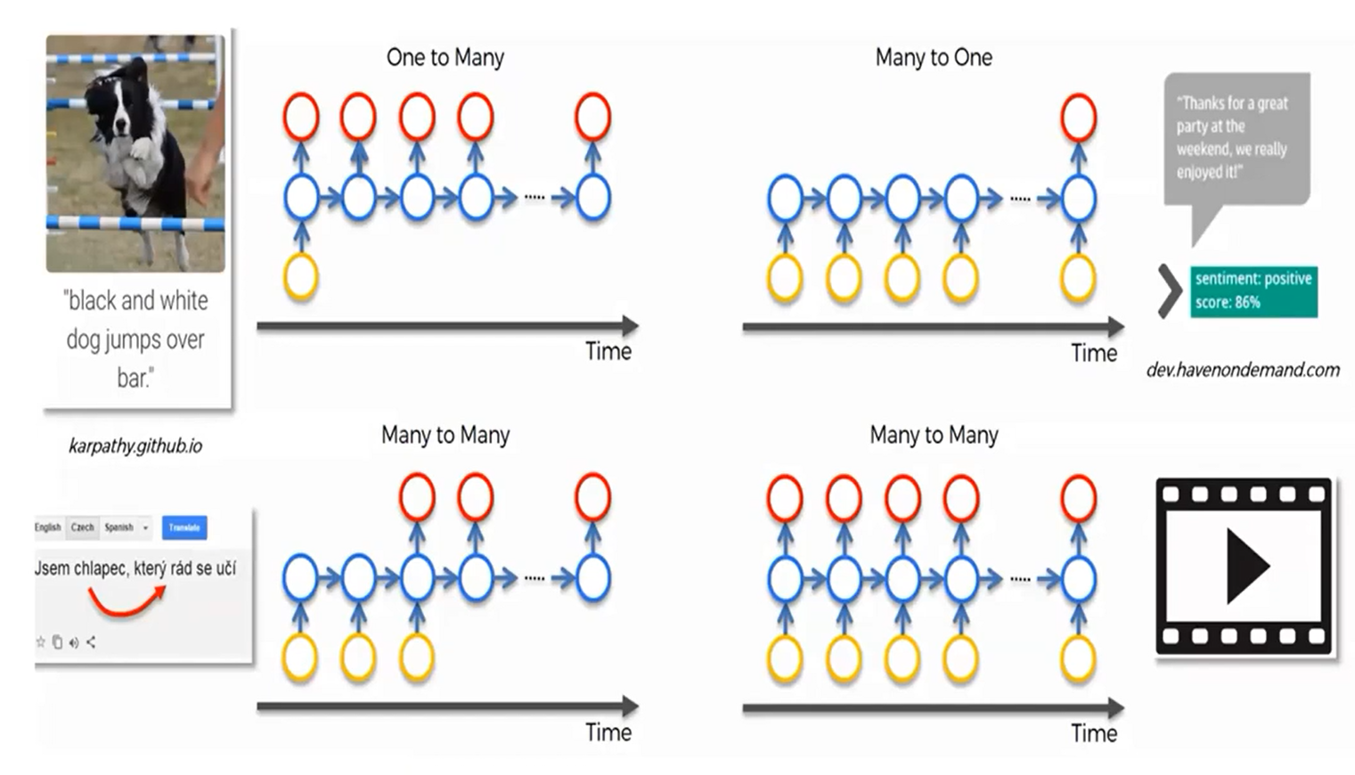

Slide 20
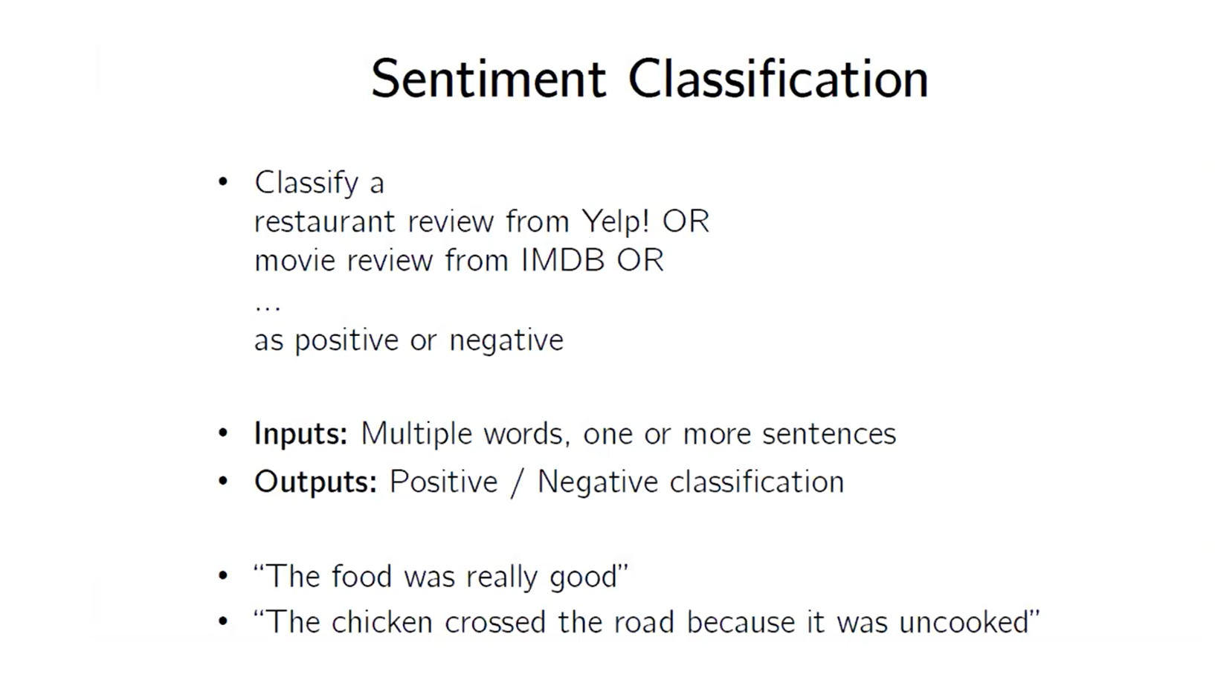

Slide 21
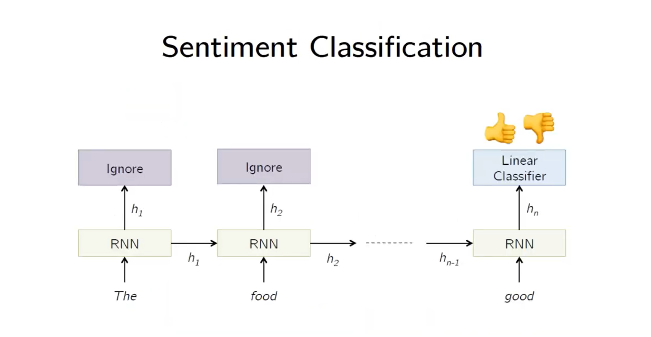

Slide 22
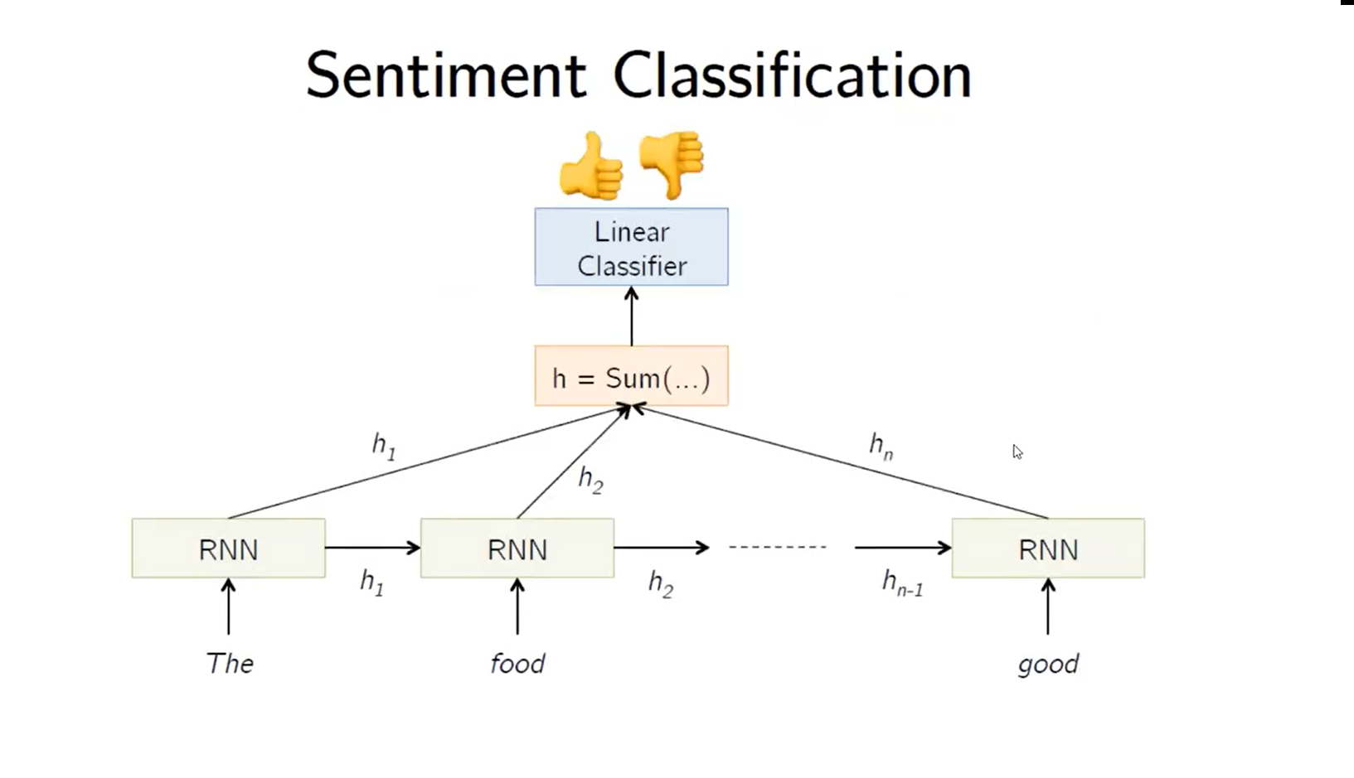

Slide 23
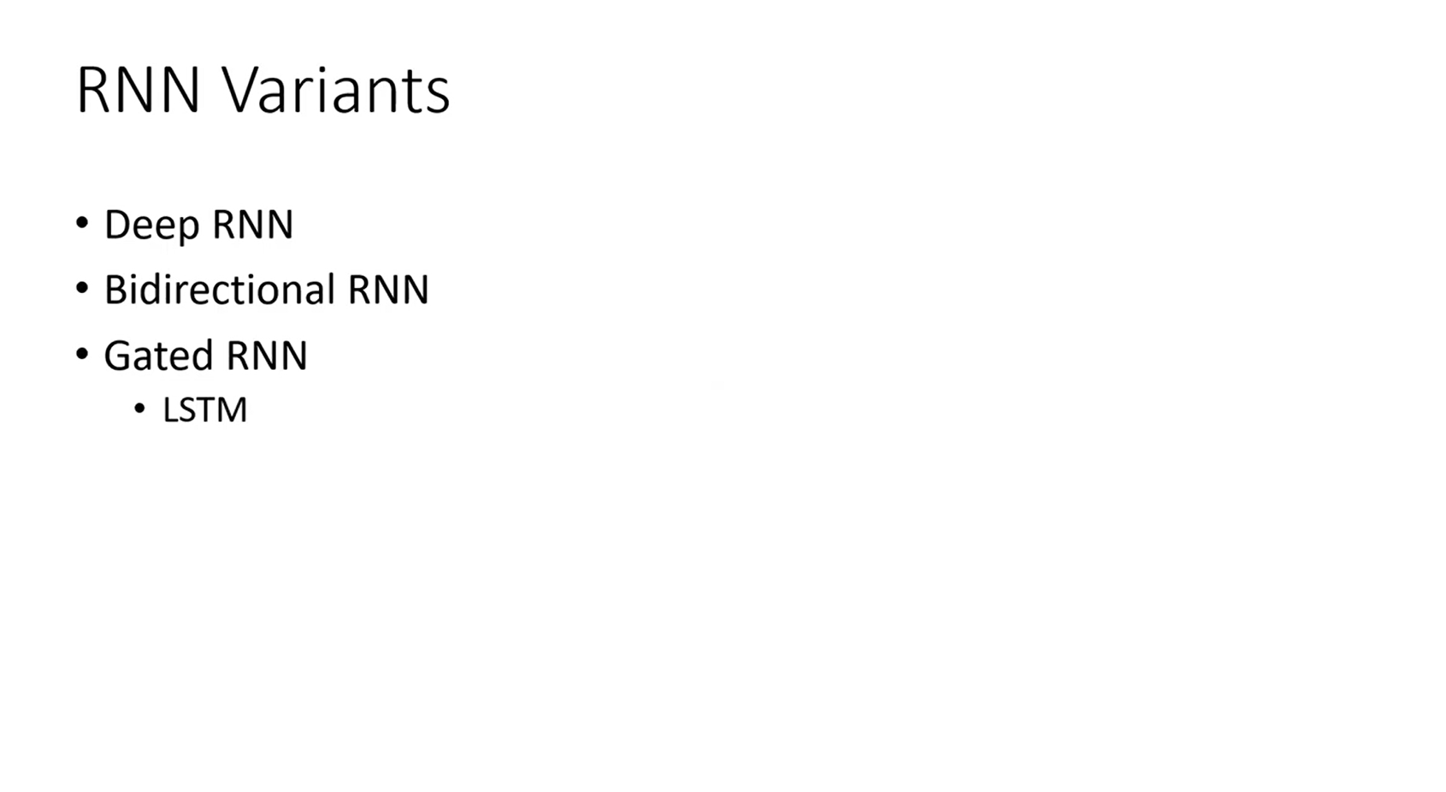

Slide 24
LSTM – Long Short Term Memory

Slide 25
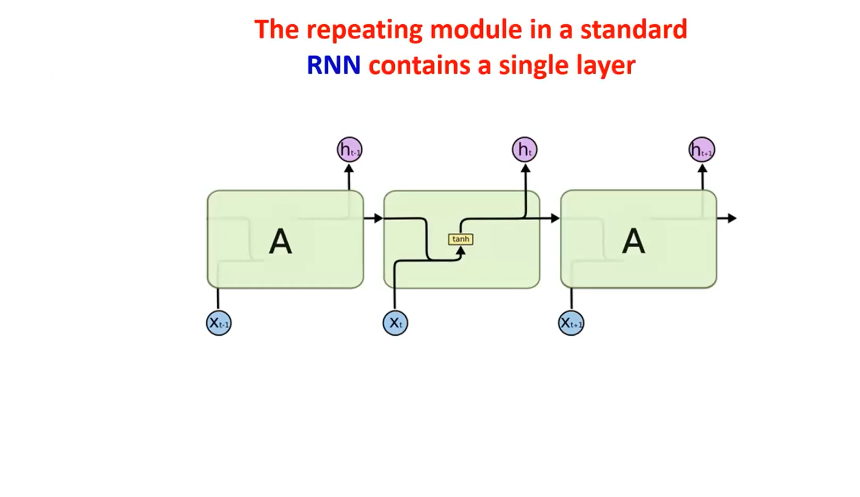

Slide 26
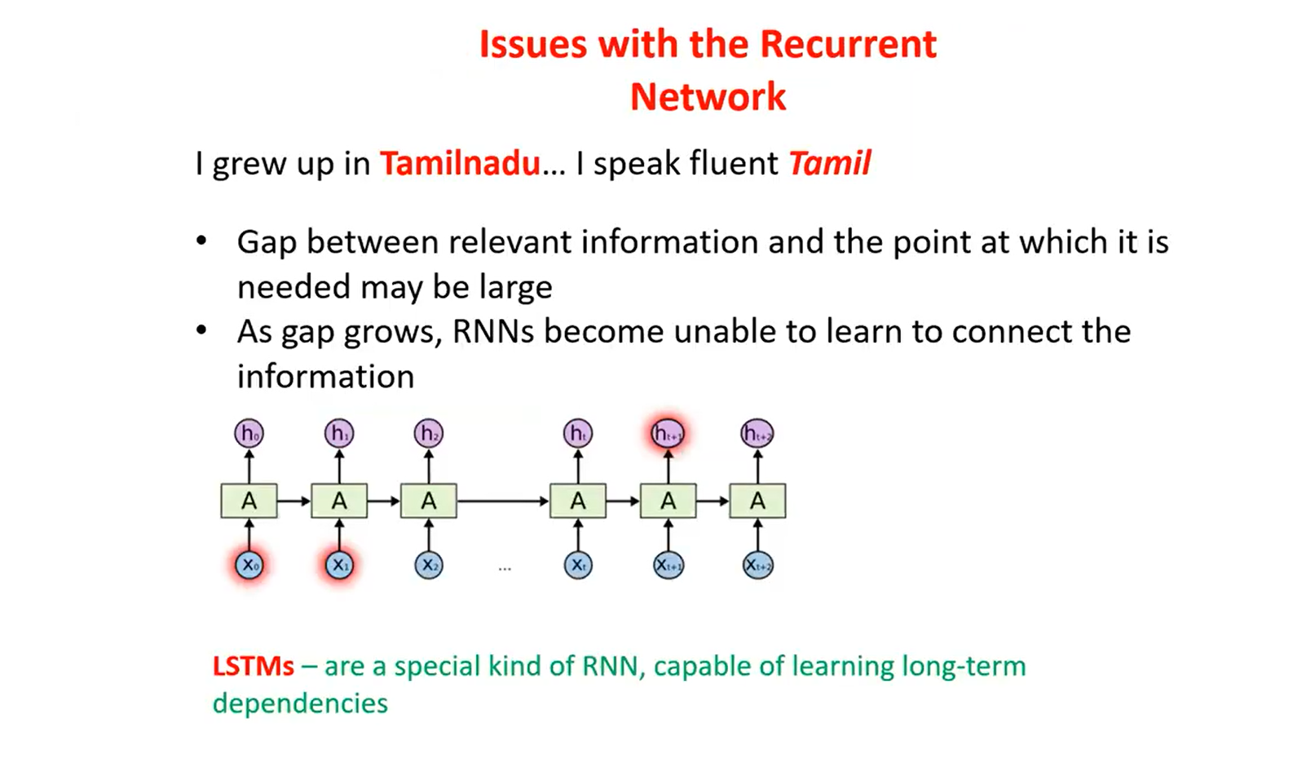

Slide 27
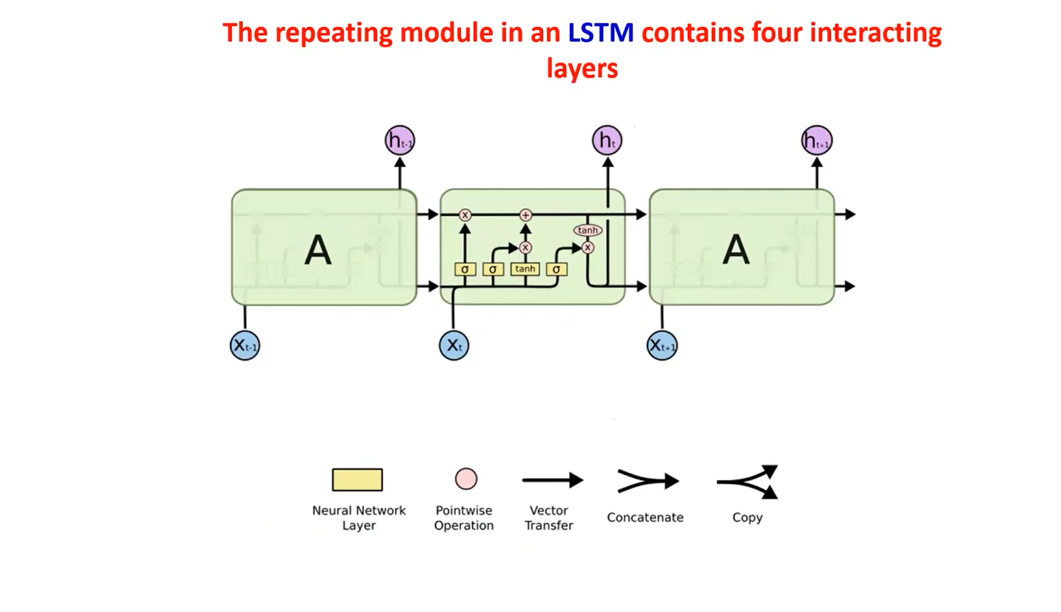

Slide 28
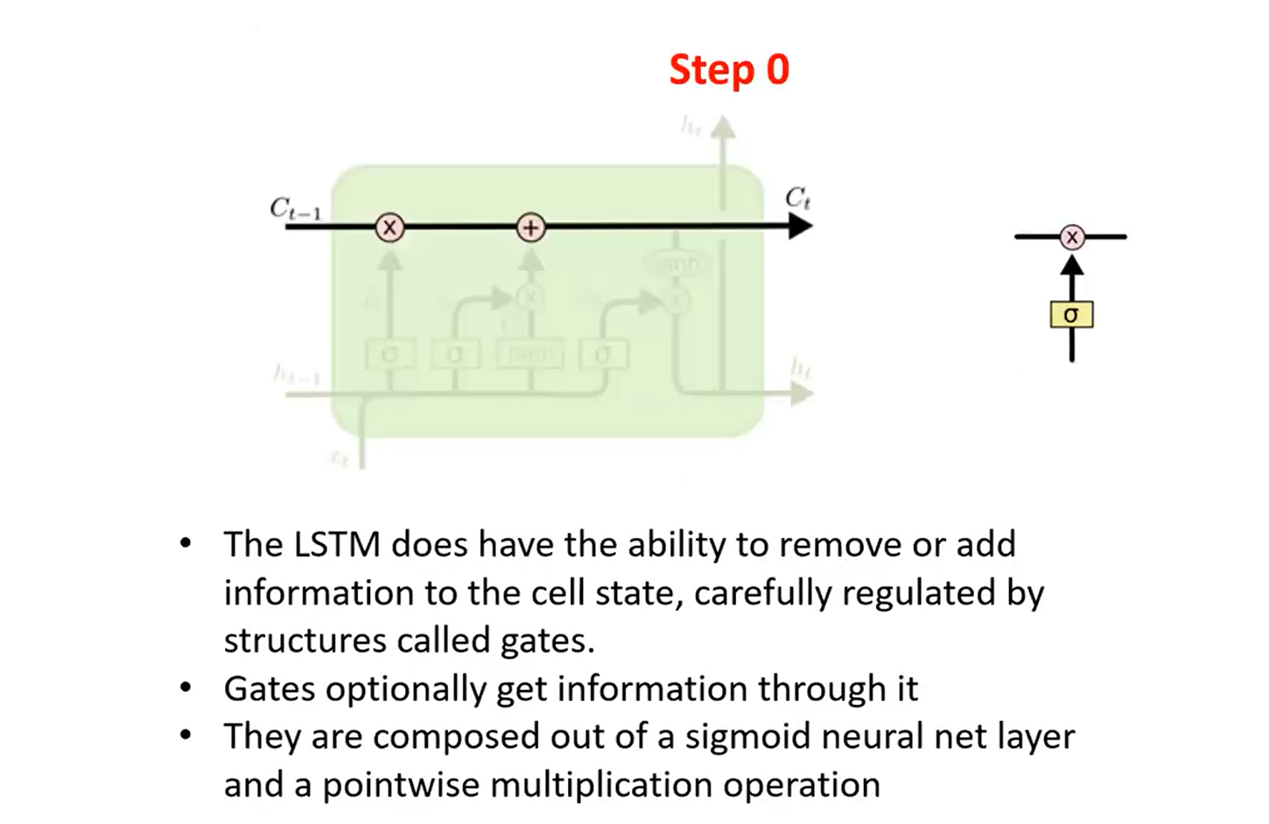

Slide 29
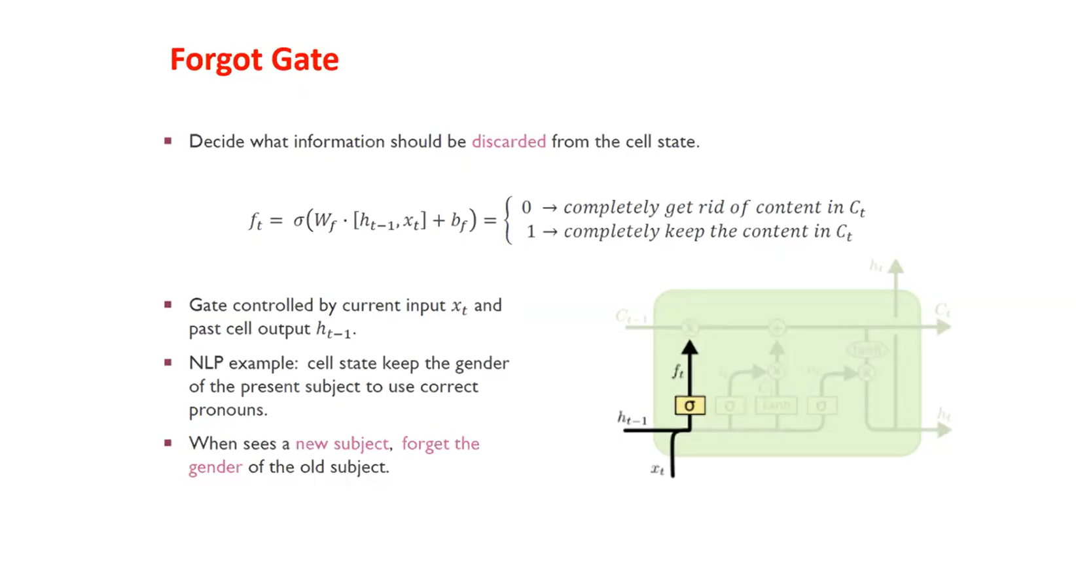

Slide 30
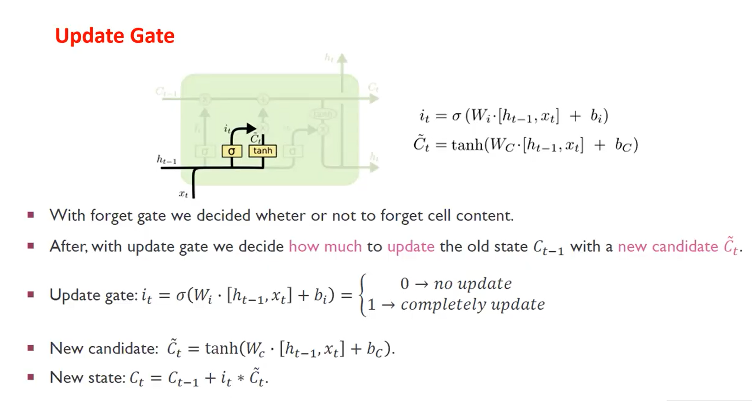

Slide 31
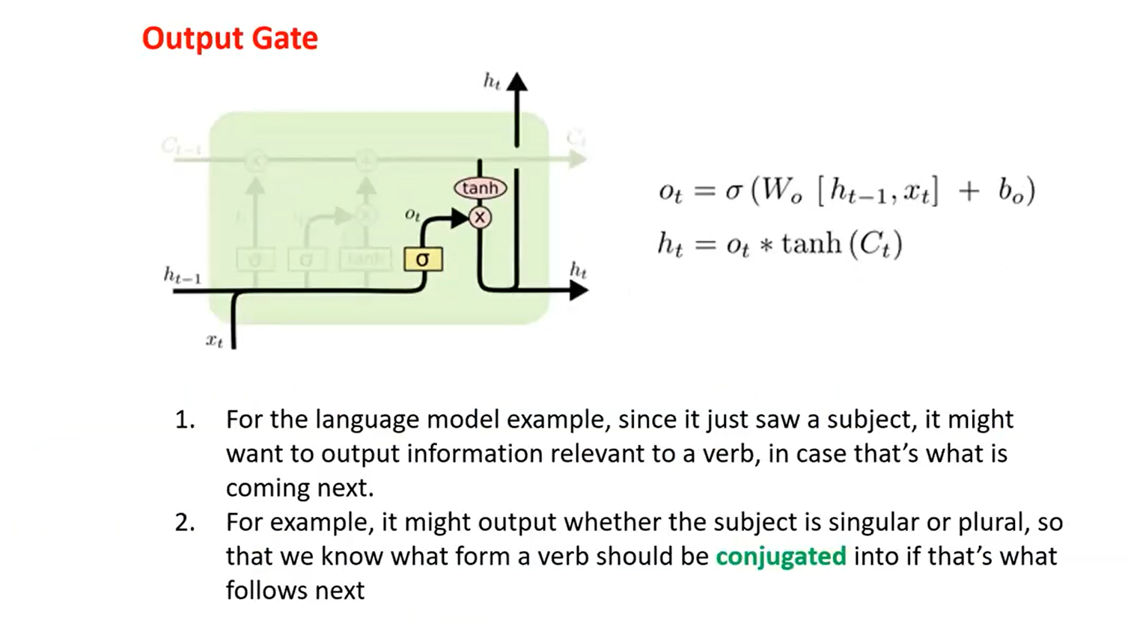

Slide 32
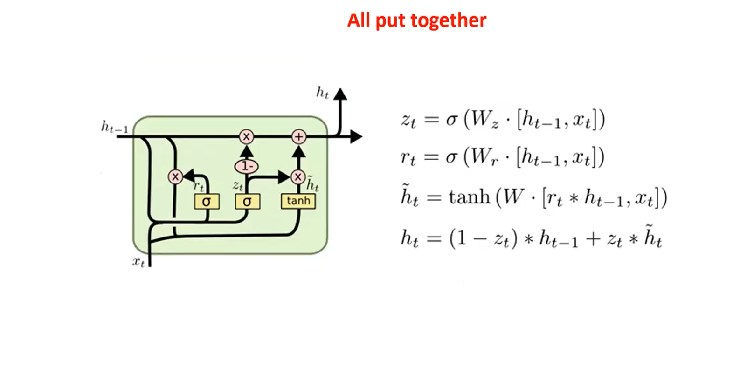

Slide 33
Thank You

